Slide 1

Implementing AES in Software
Presenter: Najmeh Nazari
Supervisor: Dr. Houman Homayoun

Slide 2


Goal
Learn
How to understand a problem from its high-level description
How to convert the solution (algorithm) of the problem into a workload for computer to solve

Slide 3
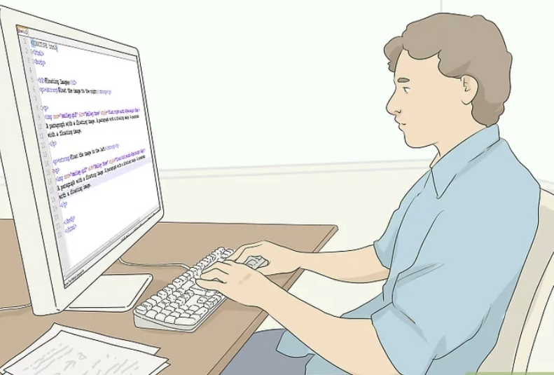
Steps to Writing a Program
Understand the problem (Defining the Problem)
Design a solution
Draw a flow chart or Write pseudo-code
Write code
Test and debug
Release program
Iterate the steps for the next version

Slide 4
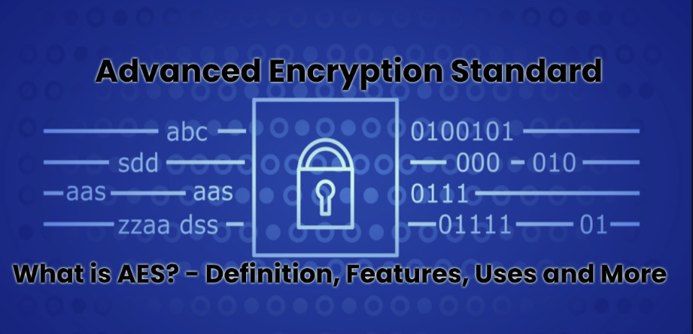
Advanced Encryption Standard (AES)
AES is a popular cipher: a method or process used to change raw information (usually human readable) into something that cannot be read. (Encryption)
uses a known, external piece of information (key), to uniquely change the data.
Reversible: it can be applied again to put the information back into its original form (Decryption)

Slide 5
AES
AES includes three block ciphers :
AES-128: Confidential
AES-192: Secret
AES-256: Top Secret
Block Size :128 bit = 16 byte
Each cipher encrypts and decrypts data in blocks of 128 bits
Fastest
The most secure

Slide 6
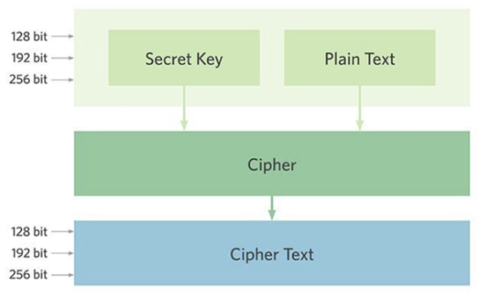
AES Design

Slide 7
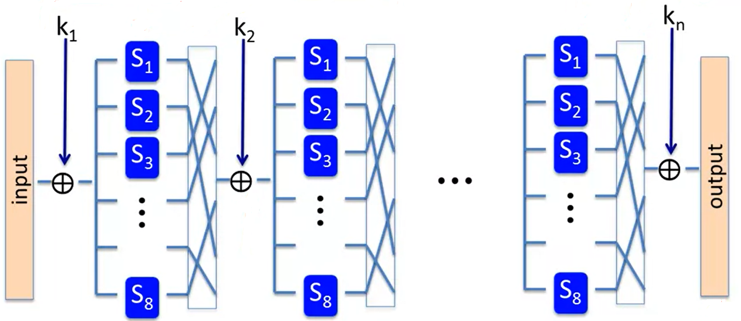
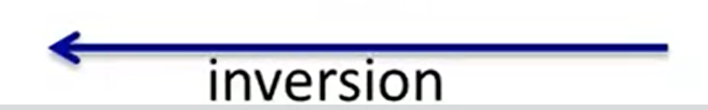
AES
Substitution-Permutation Network
Round
Perm.
layer
Subs.
layer

Slide 8
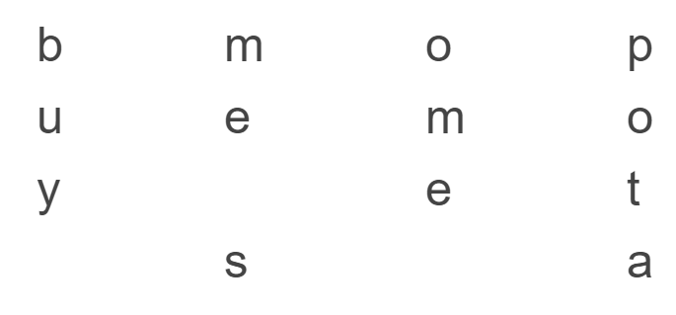
Data Division
Data is divided into blocks
128-bits(four-by-four column of sixteen bytes )
Example:
“buy me some potato chips please”
“…to chips please” would normally just be added to the next block

Slide 9
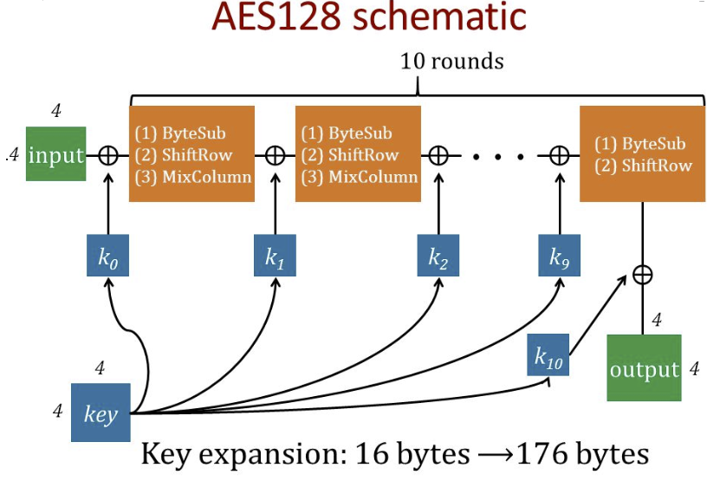
AES 128 schematic

Slide 10
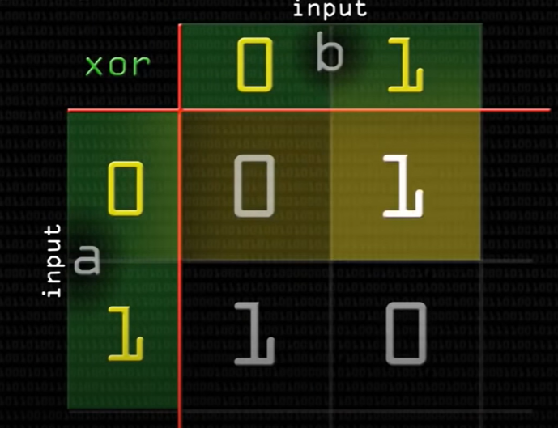
Round Function
XOR
Byte Sub
ShiftRows
MixColumns
Add round key
Substitution
Permutation

Slide 11
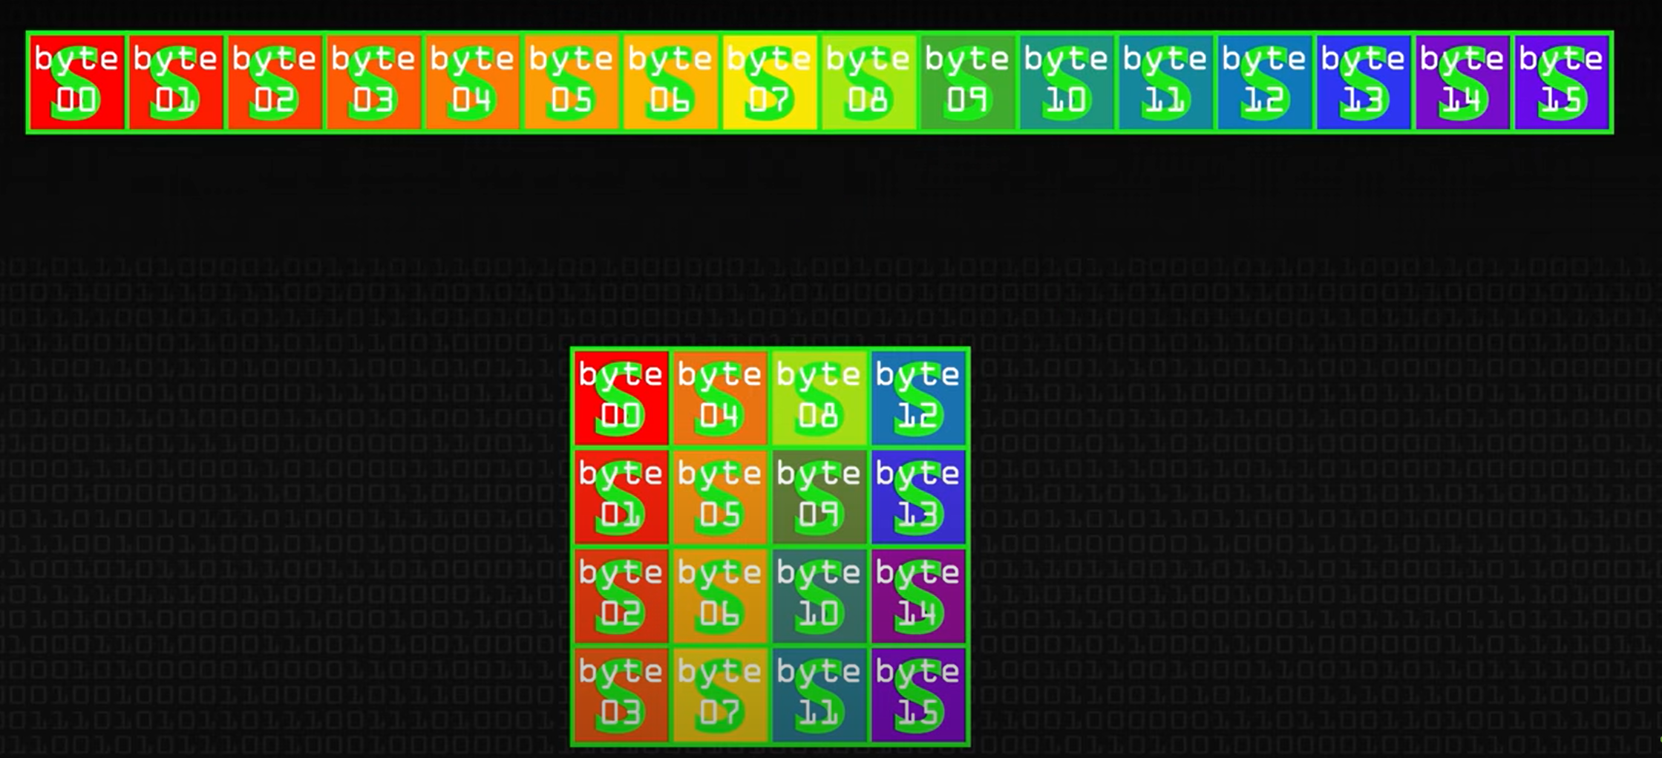
ByteSub
A 1-byte S box
256 byte table
Can be implemented by LUT(LookUpTable)

Slide 12
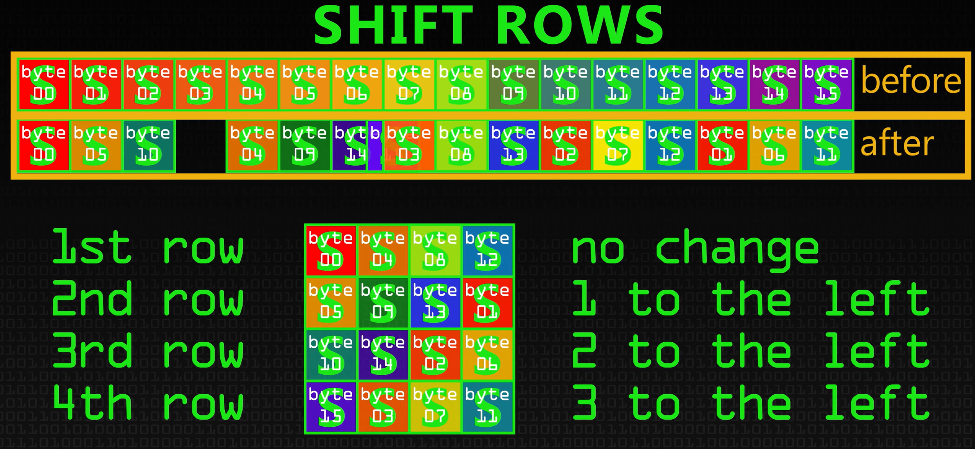
Shift Row

Slide 13
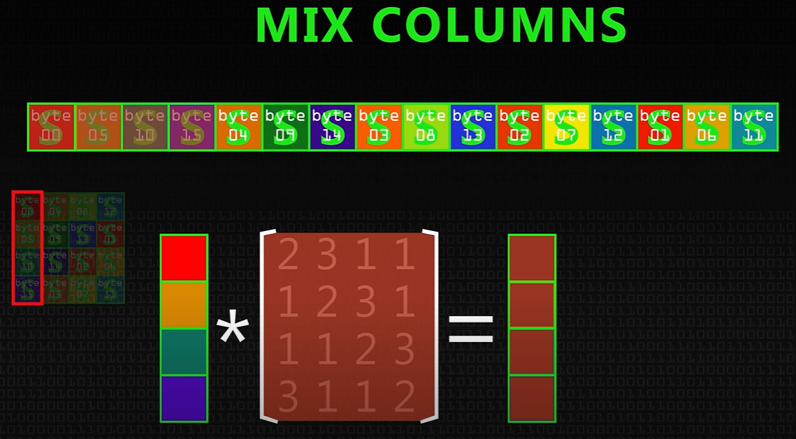
Mix Column

Slide 14
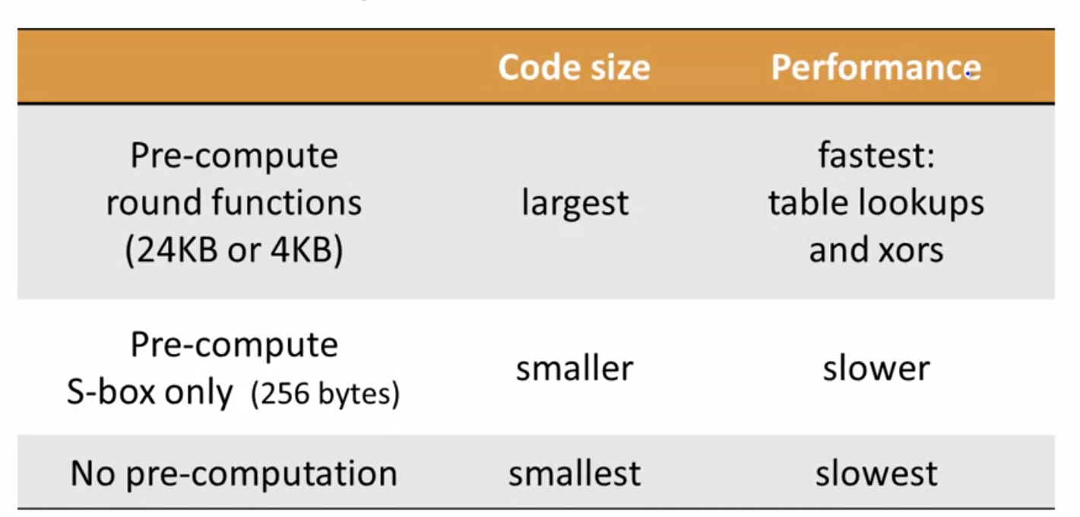
Code size/performance tradeoff

Slide 15
AES in Hardware
AES instruction in Intel Westmere
128 bit registers: xmm1 = state, xmm2 = round key
aesenc : one round of AES
9
aesenclast : the last round of AES
Without columnMix
aesenc xmm1, xmm2; //puts result on xmm1
14 × speed-up over OpenSSL on samehardware

Slide 16
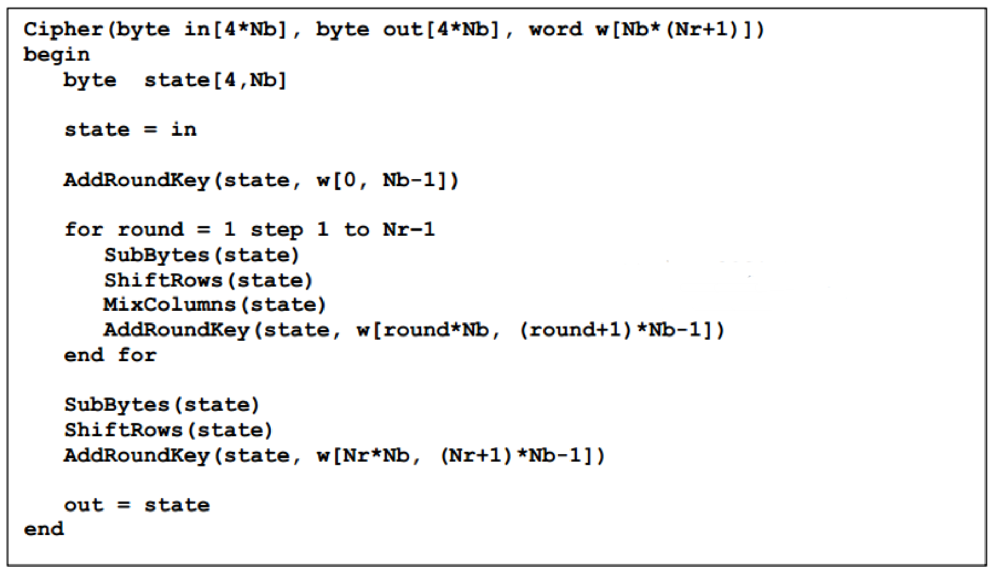
AES Psudo Code
You can find details in document

Slide 17
Assignment
The student must write a code that can perform AES-128 on an input string and write the result in a file.
The template file is provided in the lab_2 directory. Template file can read the key from a file.
Students must Implement the Mixcolumns() in two ways (lookup table, and function) and compare the speedup of the AES.
They can follow Lab_1 instruction to upload the template files in Jupyter environment and then follow these instructions to compile and run their program

Slide 18
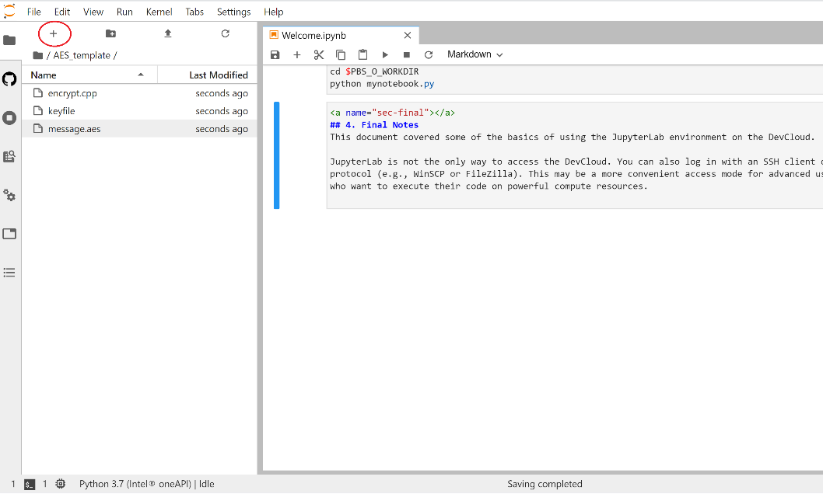
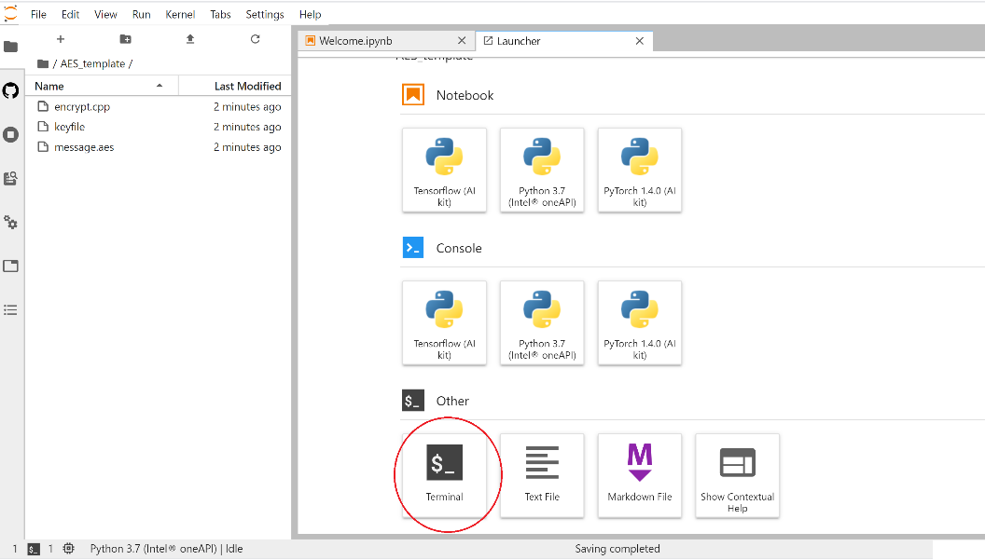
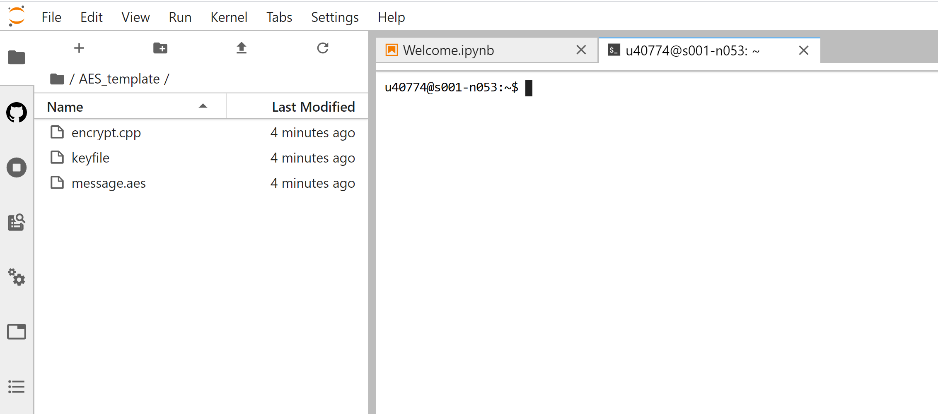
Assignment
How to open a terminal:
1
2
3

Slide 19
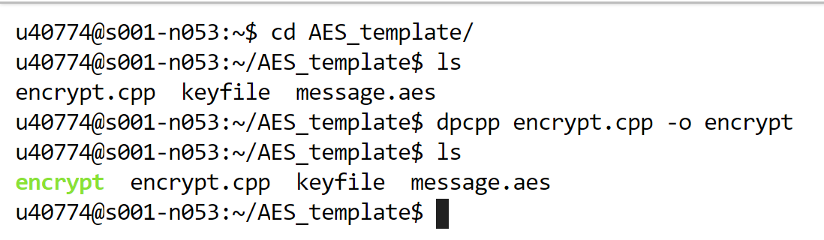
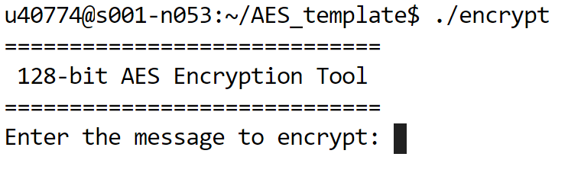
Assignment
How to compile the code and create the executable output:
1
Similar to Linux environment, got to AES directory. Then run following command:
2
$ dpcpp <name of file to be compiled> -o <name of output file>
3
run the executable output with following command:
$ ./encrypt

Slide 20
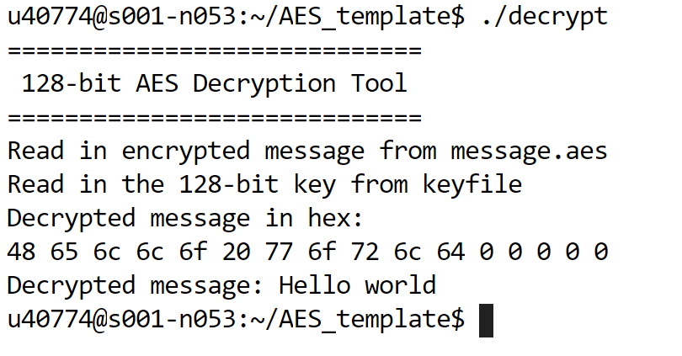
Assignment
We will provide an executable decrypt file to check if your encryption is correct!

Slide 21
Thank you

